Slide 1
BFX-UA300 (K18X001.00) CH-Down Key Function Fail Report
Prepared by: Do Thi Phuong
Review by: Michael
Date: May 21th 2022

Slide 2
D1. Establish the Team
Team Leader
Team Member
PE: Michael, Phuong
ME: Cheng Lun, Wen Thai
PM: Ben Zheng, An Tran
PD: Ruan Wen Yong
QA: Ken, Rachel
TE: Mark Wu, Allan Pham
IE: Hai Ly, Heng Ruan
Foxconn
  MFG Director: David Yin
  QA Manager : CB Lin, Toney

Slide 3
D2. Description
1. Issue Description
- On 05/05/2022, ALT customer complaint 1pcs CH_down key function failure.
- Failure status: Plug HDMI port, Ethernet port then see NG product already login SKB and CH-down key always works (push channel back)
Failure information:
Fox_SN | Cus_SN | MAC | ERROR CAUSE
YW61SCP | 2149695001202109001335 | A8934AFE8191 | CH_down key function failure

Slide 4
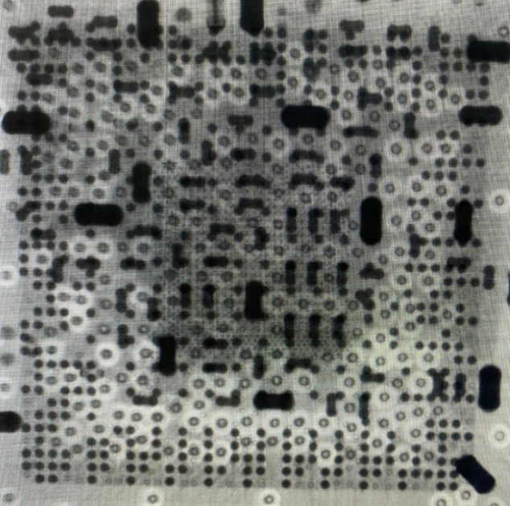
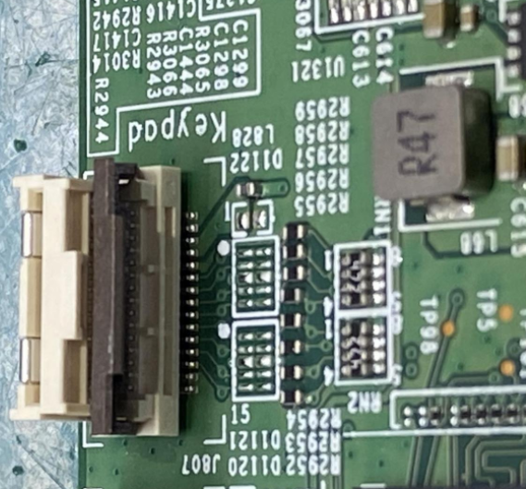
D3: Containment
1. OBA checking, Take X-ray and VI PCBA
1. OBA checking→ CH-down key always works (push channel back).
2. Baking PCBA with 70ºC in 24 hours. → Re check boot up normal.
3. Recheck OBA → CH-down key still always works (push channel back).
4. Take X-ray and VI PCBA focus on button block → Did not find out any abnormality.
X-ray SoC(U1)
Button keypad block

Slide 5
D3. Containment
1. Check FATP and OBA record data
FATP: NG product tested pass at FATP
OBA: Product wasn’t tested at OBA station
Note: OBA station only test random 10% production quantity
SERIAL_NUMBER | MO_NUMBER | GROUP_NAME | IN_STATION_TIME | WIP_GROUP
A8934AFE8191 | 2639001581 | ASSY | 11/2/2021 7:59:27 AM | BT
A8934AFE8191 | 2639001581 | BT | 11/2/2021 8:00:24 PM | PT
A8934AFE8191 | 2639001581 | PT | 11/2/2021 8:08:41 PM | UP
A8934AFE8191 | 2639001581 | UP | 11/2/2021 8:13:28 PM | ASSY2
A8934AFE8191 | 2639001581 | ASSY2 | 11/4/2021 2:11:54 AM | ASSY3
A8934AFE8191 | 2639001581 | ASSY3 | 11/4/2021 2:17:44 AM | ASSY4
A8934AFE8191 | 2639001581 | ASSY4 | 11/4/2021 2:22:32 AM | FT1
A8934AFE8191 | 2639001581 | FT1 | 11/4/2021 2:42:46 AM | FT2
A8934AFE8191 | 2639001581 | FT2 | 11/4/2021 4:17:07 AM | FT3
A8934AFE8191 | 2639001581 | FT3 | 11/4/2021 4:29:23 AM | RC
A8934AFE8191 | 2639001581 | RC | 11/4/2021 4:31:13 AM | RC1
A8934AFE8191 | 2639001581 | RC1 | 11/4/2021 4:38:59 AM | VI
A8934AFE8191 | 2639001581 | VI | 11/4/2021 10:51:25 AM | RC2
A8934AFE8191 | 2639001581 | RC2 | 11/4/2021 10:55:57 AM | VI1
A8934AFE8191 | 2639001581 | VI1 | 11/4/2021 10:59:42 AM | PACK_BOX
A8934AFE8191 | 2639001581 | PACK_BOX | 11/4/2021 11:02:07 AM | CHECK_WEIGHT
A8934AFE8191 | 2639001581 | CHECK_WEIGHT | 11/4/2021 11:04:51 AM | PACK_CTN
A8934AFE8191 | 2639001581 | PACK_CTN | 11/4/2021 11:05:16 AM | PACK_PALT
A8934AFE8191 | 2639001581 | PACK_PALT | 11/4/2021 2:01:33 PM | FQA
A8934AFE8191 | 2639001581 | FQA | 11/4/2021 2:45:18 PM | CHK_PALT
A8934AFE8191 | 2639001581 | STOCKIN | 11/4/2021 4:23:33 PM | FG

Slide 6
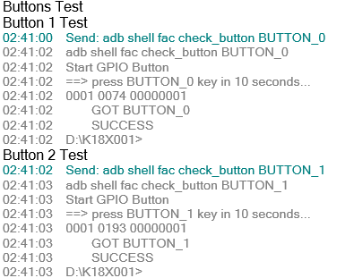
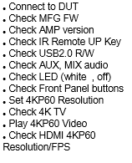
D4. Root Cause
1. Check log test at FATP
Check log test is normal
...
FT1
...
Test plan FT1 station
Log test of product at FT1 station: Pass
Summary:
- NG product test pass normal at FT1 station, Didn’t find out any abnormal related to button function.

Slide 7
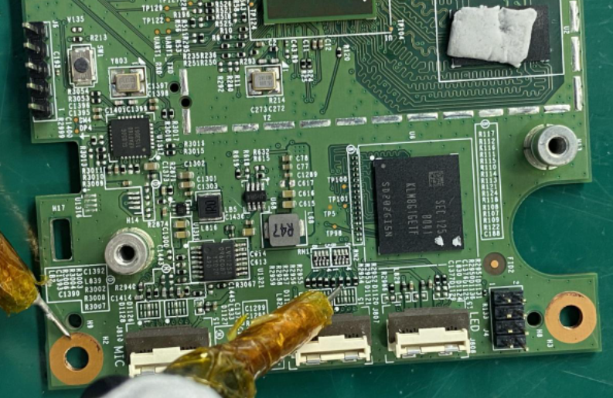
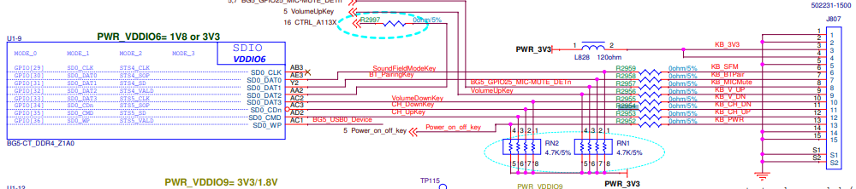
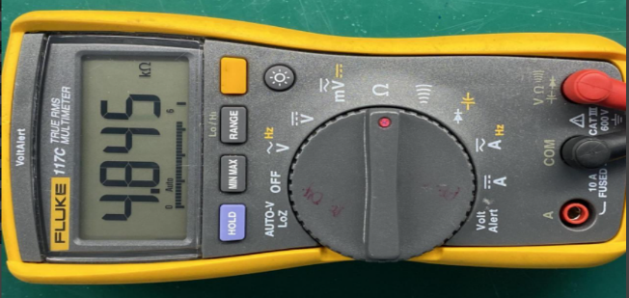
D4. Root Cause
2. Check button block on main board
Check impedance on button block ➔ No abnormality
- Follow circuit diagram at button block, The remote signal from SoC to keypad jack (J807 location) go through resistor R2954 (0 ohm) with pulled resistor RN1 (4.7K ohm).
- Measure impedance at R2954 location and compare with OK product(OK product has impedance~4.8K). ➔ Normal
Measure impedance at R2954 location
circuit diagram of Button block
Summary:
- Check impedance of NG product is normally

Slide 8
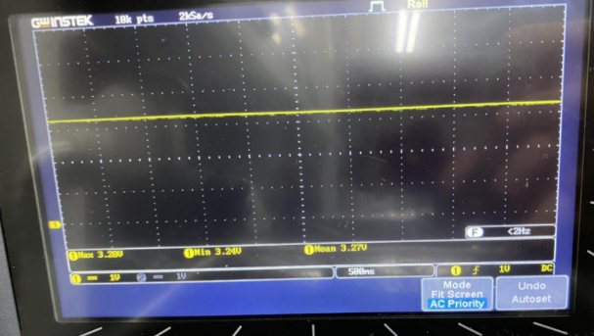
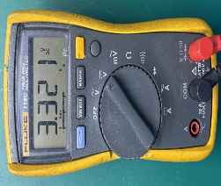
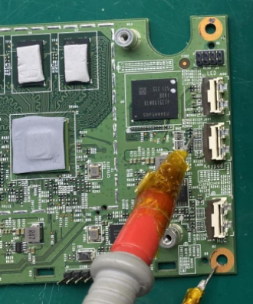
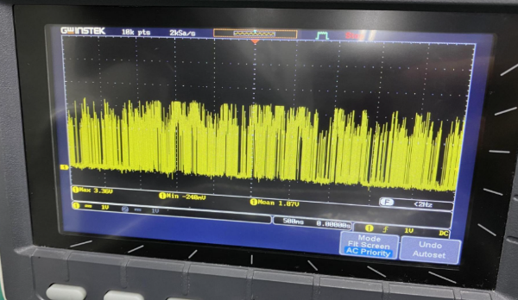
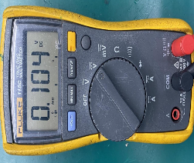
D4. Root Cause
3. Check button block on main board
Remark: On theority, The remote signal of keypad is set to “0”_Press button (~ 0.0V) – keypad is enabled,
“1”_ No press button (~ 3.3V) – Keypad is disabled.
Check Voltage at R2954 location when disconnect internet
Case 1: Press CH-down key button ➔ The voltage ~ 0.0V _ keypad is enabled. ➔ Normal
Case 2: No press CH-down key button ➔ The voltage ~3.3V_Keypad is disabled. ➔ Normal
Check Voltage at R2954 location when connect internet
Case 1: Press CH-down key button ➔ The voltage ~ 0.0V _ keypad is enabled.➔ Normal
Case 2: No press CH-down key button ➔ Figured out the voltage at this location is unstable (has 2 status: 0.0V and 3.3V) while voltage of OK board is always 3.3V).
Power at R2954 location_3.3V
Power at R2954 location
OK sample
NG sample
Kept only 1 status
Status 1
Status 2
Check voltage at R2954 location when connect internet_Case 2.
Summary:
- This issue happen when product already login SKB and connect internet.

Slide 9
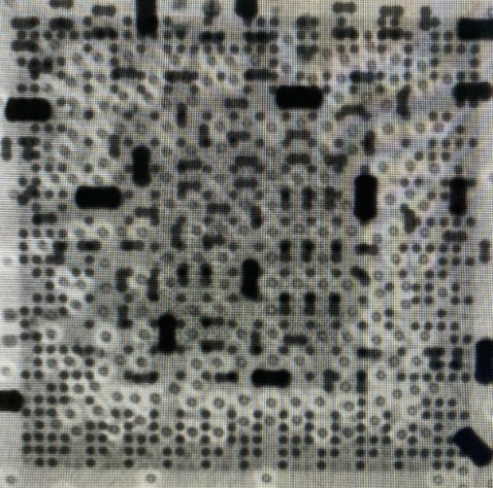
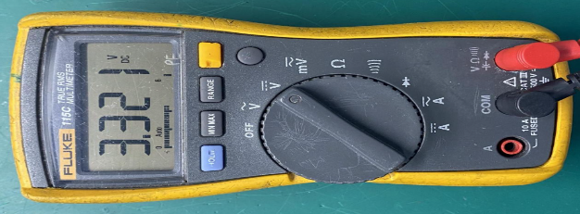
D4. Root Cause
4. Re-solder SoC(U1)
- Re solder SoC (U1)
- After re-solder SoC (U1), X-ray SoC (U1) location, check boot up and voltage at R2954 when connect internet and no press CH_down key button➔ Normal
Before re-solder SoC( U1) location
After re-solder oC( U1) location
Check power at R2954 location when connect internet
Summary:
- Re-solder SoC (U1) measure voltage at R2954 when connect internet and no press CH_down key button is 3.321V ➔ Normal

Slide 10
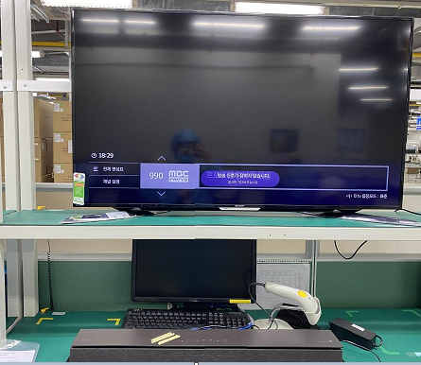
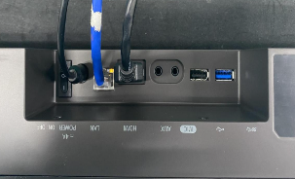
D4. Root Cause
5. Re-test NG product
- Test NG product at OBA station (connect internet, open channel 990 and power on 24 hours)
- Test product from 05/15,8:00 AM to 05/16, 8:00 AM
➔ Result: Channel 990 is kept for 24H power on
Time | Result
8:00 | Channel 990
10:00 | Channel 990
12:00 | Channel 990
14:00 | Channel 990
16:00 | Channel 990
18:00 | Channel 990
20:00 | Channel 990
22:00 | Channel 990
0:00 | Channel 990
2:00 | Channel 990
4:00 | Channel 990
6:00 | Channel 990
8:00 | Channel 990
Summary:
- Channel 990 is kept for 24H power on

Slide 11
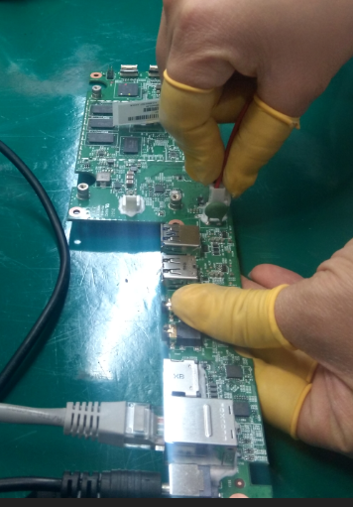
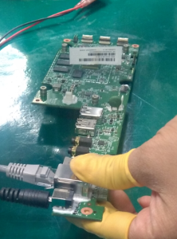
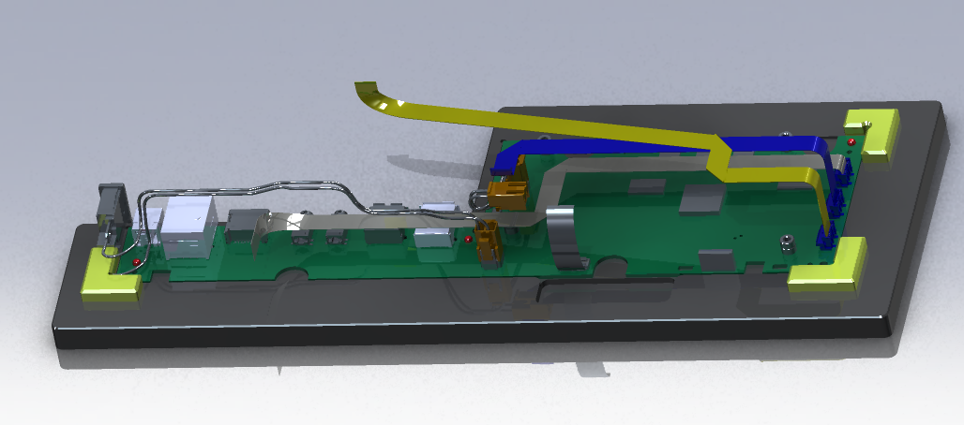
Conclusion
1. Summary for root cause
Root cause:
- This issue happen when product already login SKB and connect internet.
- As an analysis above, and production history suspect SoC(U1) pin cracked
“ In 2021/11 at BT, UP, PT station dont have jig to fix PCBA when test and assembly to prevent PCBA deformed”
Action:
- Apply Jig at BT, PT, UP station for test and assembly to prevent PCBA deformed. Done: 2021/12
- Fii will keep monitoring this issue on FATP.
In 2021/11 at BT, PT, UP station don’t have Jig
Appply Jig from 2021/12

